Slide 1
Introduction to Software Business Product management
Week 3 Day 1
Led by: Emily Crose
for
Oakland University

Slide 2
Review of Week 2

Slide 3


Questions From Week 2?

Slide 4
Terms to listen for
Sprint
A period of focused development
Roadmap
An overarching plan for development

Slide 5
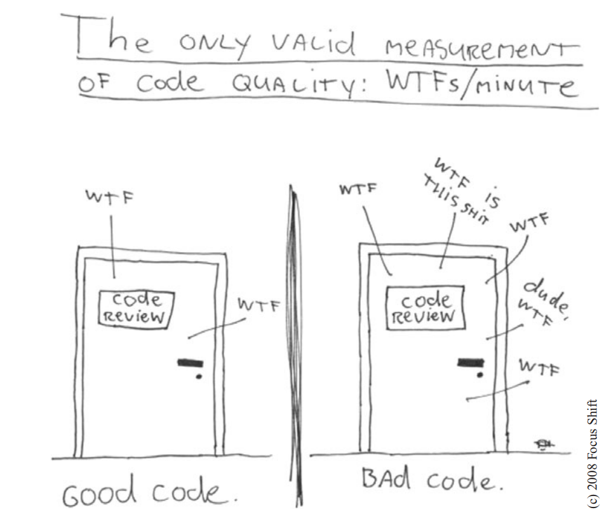
Notes:
I snipped this out of a book called “Clean Code: A Handbook of Agile Software Craftsmanship”. In the book, author Robert C. Martin begins the first chapter by explaining that this is the goal of a good software development process. The aim of software is not to be perfect, it’s to produce the cleanest code possible.

Slide 6
Form
Usability
UI
Function
Low complexity
Features
Minimalist code
Notes:
When we design software, we approach the ages old problem of form vs. function. We want programs that work the way they are supposed to. We want them to do what they need to do, and nothing more. But we also want them to look and feel professional without sacrificing functionality.
Back in 2012, I lived in Australia for 6 months. While I was there, I made a friend who I spent most of my free time with named Paul. Paul was a great guy, worked in the same security operations center that I did, but Paul had an axe to grind, for whatever reason, with the idea of art being an important part of design.
We argued about this between us more than once, but he just couldn’t see the value of having people who understood aesthetics in any way. I tried to get him to recognize the application of art through proving that Apple computers have historically done a pretty good job of balancing form and function over the years. You could say that at different times they took it too far in one way or the other, but Apple engineers have proven that they understand this concept pretty well.
Aesthetics, by the way, don’t end at the UX. We can also apply concepts like the aesthetic of minimalism to our coding practices themselves.

Slide 7
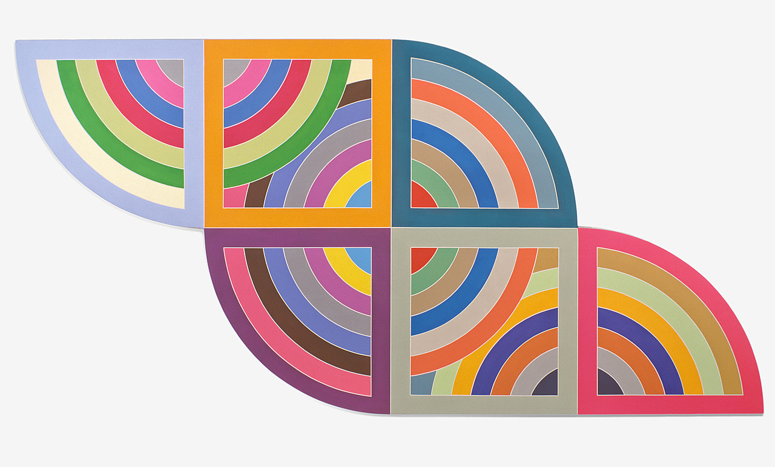
Notes:
This is an art piece by artist Frank Stella called Harran II. This piece of art is hanging in the Guggenheim museum in New York. The lesson of this slide is to convey the idea that there’s a beauty in balancing function with minimalist form. It’s easy to think of art as purely frivolous expression of form over function, but even in minimalist art like this piece, there’s still a functional goal. The functional goal of any piece of art is to evoke an emotion in the viewer. Does this piece inspire any particular feeling in any of you?
The thing I love about this piece of art is that it has contrasting colors. It’s simple, two square shapes, four quarter circles, and radiating complementary colors, but what Stella does with this piece creates an a seemingly neverending sequence of colors and shapes. The places where the piece overlaps, where it doesn’t, the negative space around the colorful parts all play a part in both the form and function of the piece itself. Much of what Harran II is doing in this piece applies to ideals of clean code.

Slide 8
The Software Development Life Cycle

Slide 9
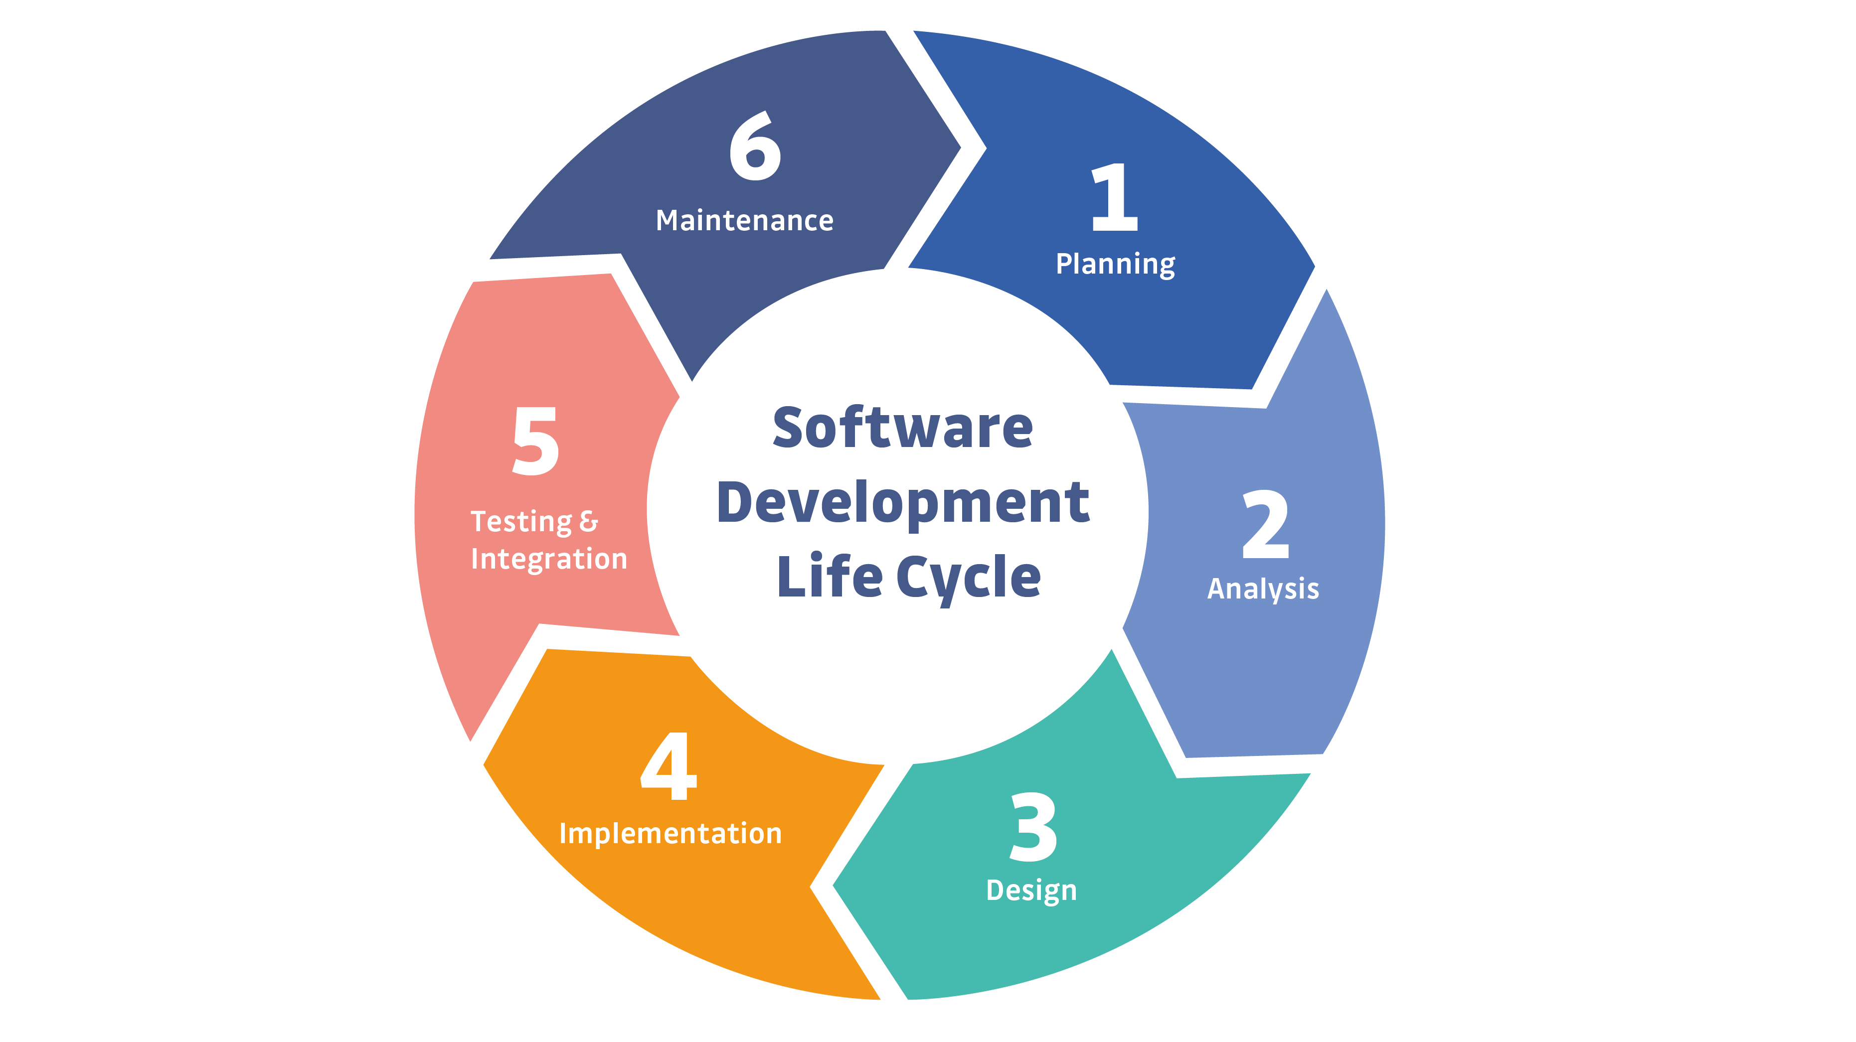
Notes:
This is a simple example of the SDLC. Typically, representations of the SDLC will have around 6 steps, but the steps will generally match what you see here.

Slide 10
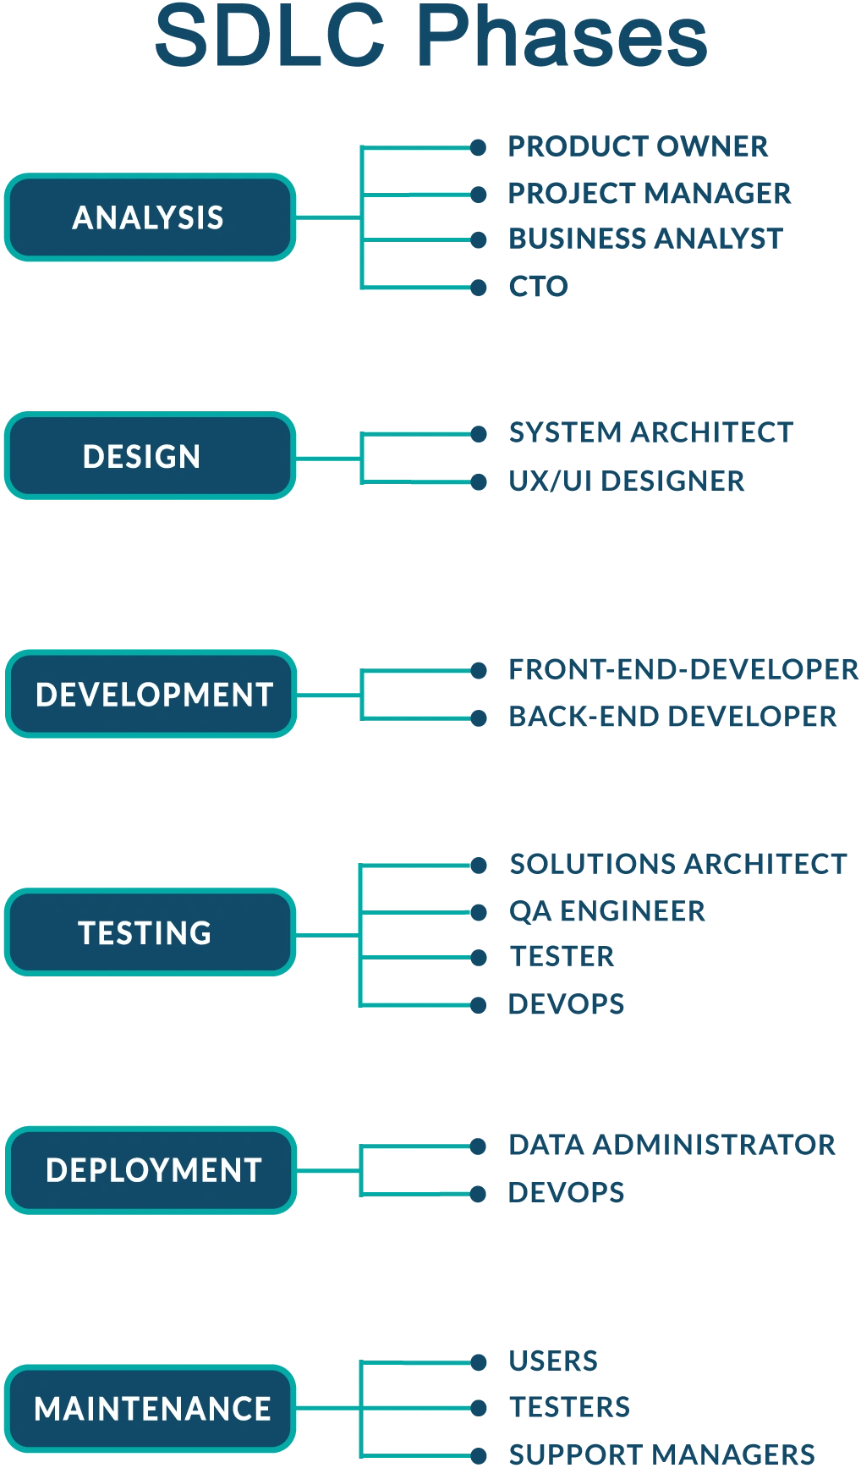
Notes:
If you’re taking notes, you’ll notice that this slide diverges from the last presentation of the SDLC. This isn’t a serious issue for us though, what we want to take away from the information we see here is the jist of planning, development, feedback, and beginning the cycle anew.

Slide 11

SDLC Step 1: Planning

Slide 12
Questions to ask ourselves in step 1
What is our problem?
Do we have the individuals we need to identify a solution to this problem?
What do we need to solve the problem?
Is the solution a problem software can fix for us?

Slide 13
Roles in Step 1
Product owner
Project manager
Business analyst
CTO

Slide 14
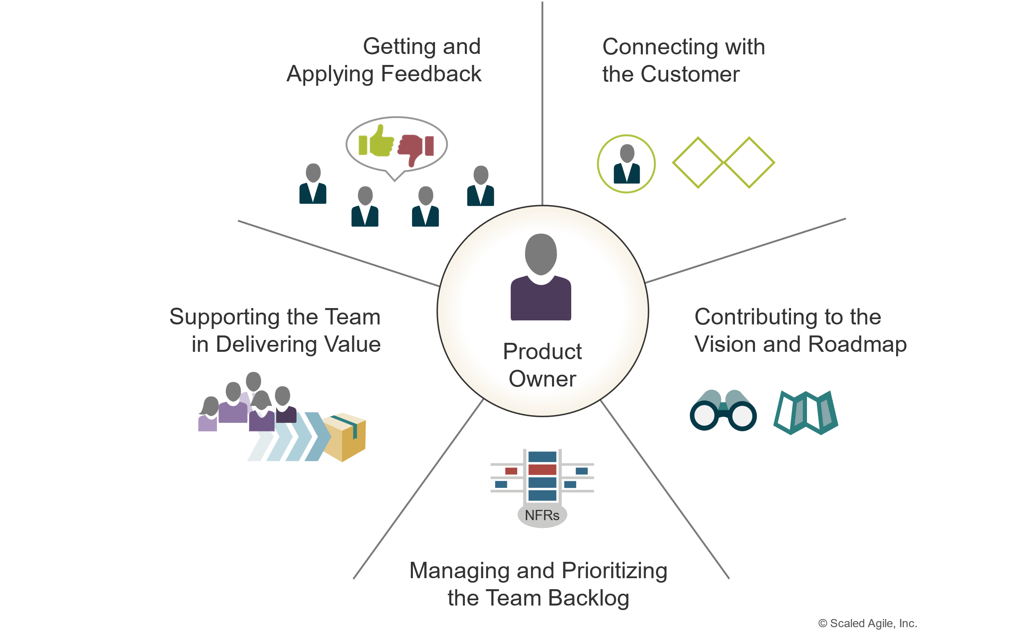
Product Owner
Notes:
According to Agile, the product owner undertakes the

Slide 15
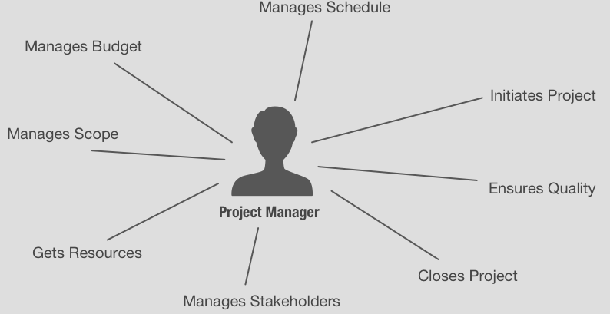
Project Manager Role

Slide 16
Business Analyst Roles & Responsibilities
Gathers & tracks product requirements
Stake holder consent
Documentation
GAP analysis
User testing

Slide 17
CTO
Provides top-cover for decision making
Budgeting Approval
Stakeholder, and final approval pre & post project

Slide 18
Planning Activities
Gathering requirements
Planning solutions
Planning sprints
Road-mapping

Slide 19
Gathering Requirements
What problems do we need to solve with an app?
How do we our app to solve those problems?
What environment(s) will our app run on?

Slide 20
Planning Solutions
Given our requirements, what features do we need?
What dependencies do we have to make the features functional?
Libraries?
What should our interface look like?

Slide 21
Tasking
“Tactical” level jobs
Should be single-focus
Do NOT overload tasks!
Can include bug-fix, but should be kept separate
Notes:
Tasking is the daily work the contributors on your team will do to progress the project goals. We mention tasking here because it’s the most fundamental building-block of getting work done.
Tasking should be categorized and organized into work that can generally be done in a week or less. A single task can take up to two weeks to complete, but if we overload tasks too much, it will become more and more difficult to see progress being made against the goals of the team.
We want to organize tasks so that our contributors feel that they are able to start a task on Monday, and close it out by Friday. This helps maintain a cadence, boosts team confidence and keeps morale high. As our team members close out tickets, they’ll get a boost of dopamine that will make them feel satisfaction at a completed job.

Slide 22
Planning Sprints
Collection of tasks
Planned around Mid-Term Goals
Typically planned for a month or more of focused worktime
Helps stay organized and focused
Notes:
We plan sprints as a way of organizing team goals into a digestible milestone. As we close tickets and get near the end of the sprint window, we will start to see our goal come together.

Slide 23
Sprints Cont’
Must be accomplishable!
Organized around quarterly goals
Only ONE sprint per team

Slide 24
Road-Mapping
Long-term goals
Plans multiple sprints in advance

Slide 25

10 minute break

Slide 26
Tools To Manage Planning

Slide 27

Organizational Tool: Jira

Slide 28
Jira Features
Create & assign tasks (or “tickets”)
Track ticket progress
Organize tasks
Integrate with other Atlassian organizational tools
Confluence
Bitbucket

Slide 29
Road-Mapping Tools

Slide 30
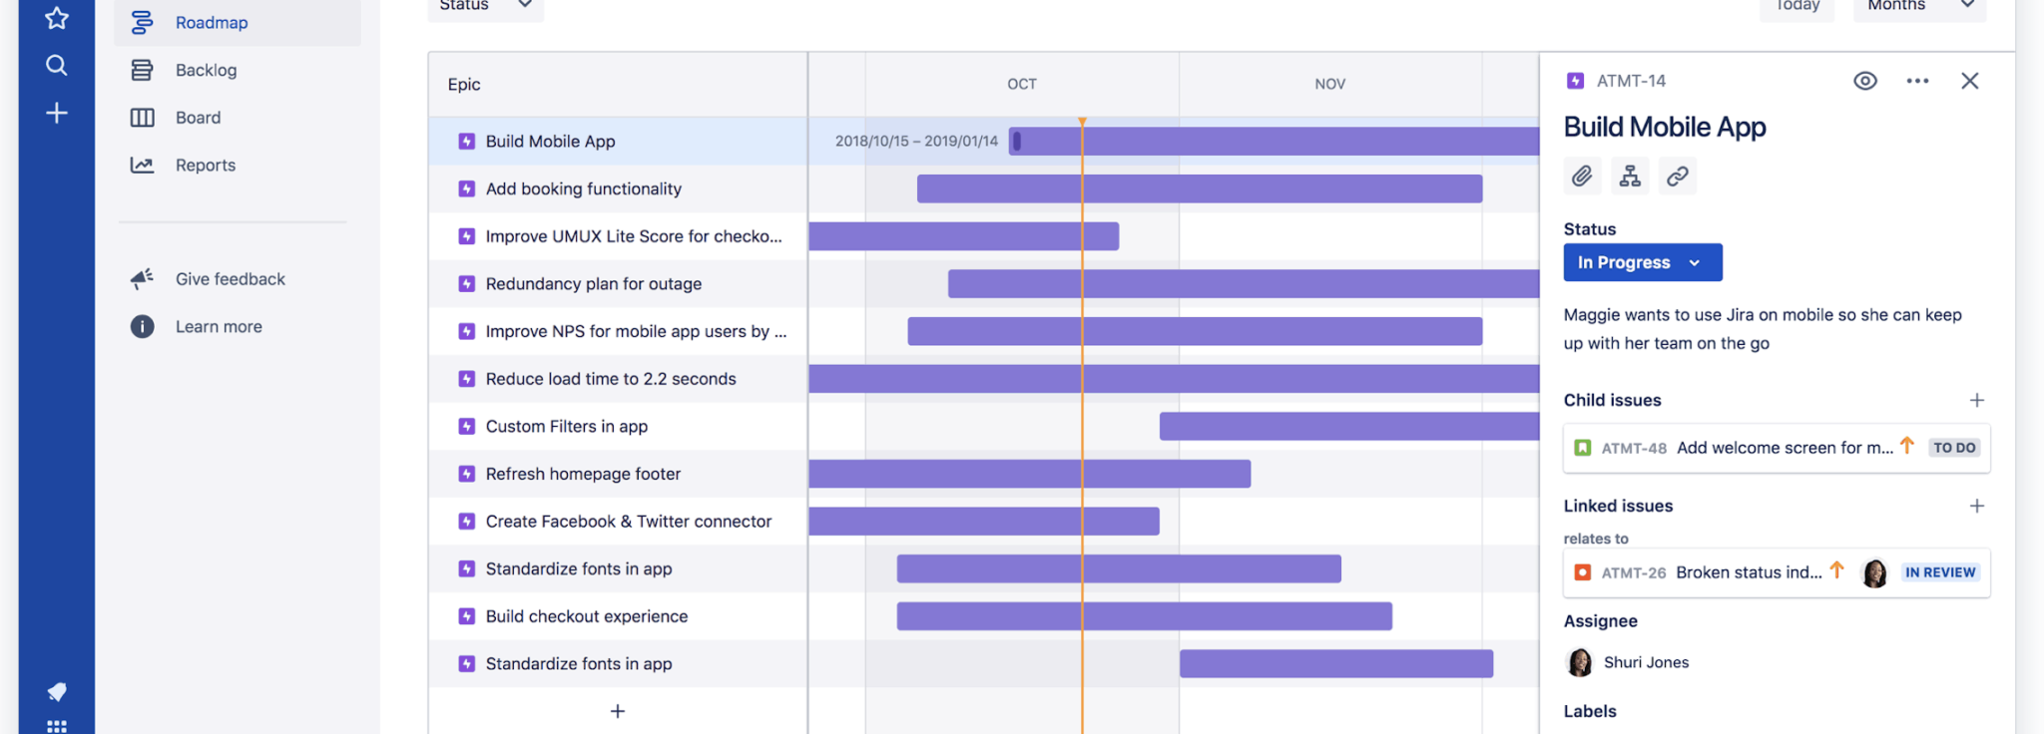

Slide 31
Epics
Overall tasks are organized into Epics
Epics are made up of tasks
Each task can have subtasks

Slide 32
Step 2: Analysis

Slide 33
Questions to ask in step 2
Does a software solution already exist for this problem?
If yes:
Can we legally/contractually use it?
How much will it cost for us to use it?
Do we need to create our own solution?
How much will it cost for us to build it?
Can we afford this cost?
How much will it cost for us to support this product?
Are we committed to supporting this new product long-term?
Notes:
Before we begin building our own solution, we should consider the following questions to help guide discussion about the right way forward.

Slide 34
Step 2: Analysis Roles
Product owner
Project manager
Business analyst
CTO
Notes:
These roles are the same as before. For the most part, we can imagine steps 1 and 2 squashed into one step where we Plan and analyze our business needs at the same time. Depending on how much effort you put into each of these steps, you may want to separate them out.

Slide 35
Analysis Activities

Slide 36
Cost/Benefit Analysis
This project will cost $X, what can we expect to see in return for this cost?
Is the value tangible or intangible?
Is the intangible benefit worth the cost?
Can we realistically afford to do this year-over-year
How much do we believe this product will cost to maintain over 3 years? 5 years?
Do we currently have the resources we need to support this project, or do we need to hire people?
If we don’t have enough devs, how many people will we need to hire?

Slide 37
Opportunity Cost Analysis
If we spend our time on this project, what are we NOT doing with our resources?
Do we have our priorities in order?

Slide 38
Agile Development Model
Work iteratively
Integrates feedback from customers
Creates achievable goals at all stages
Reduce feature engineering complexity

Slide 39
10 minute break

Slide 40
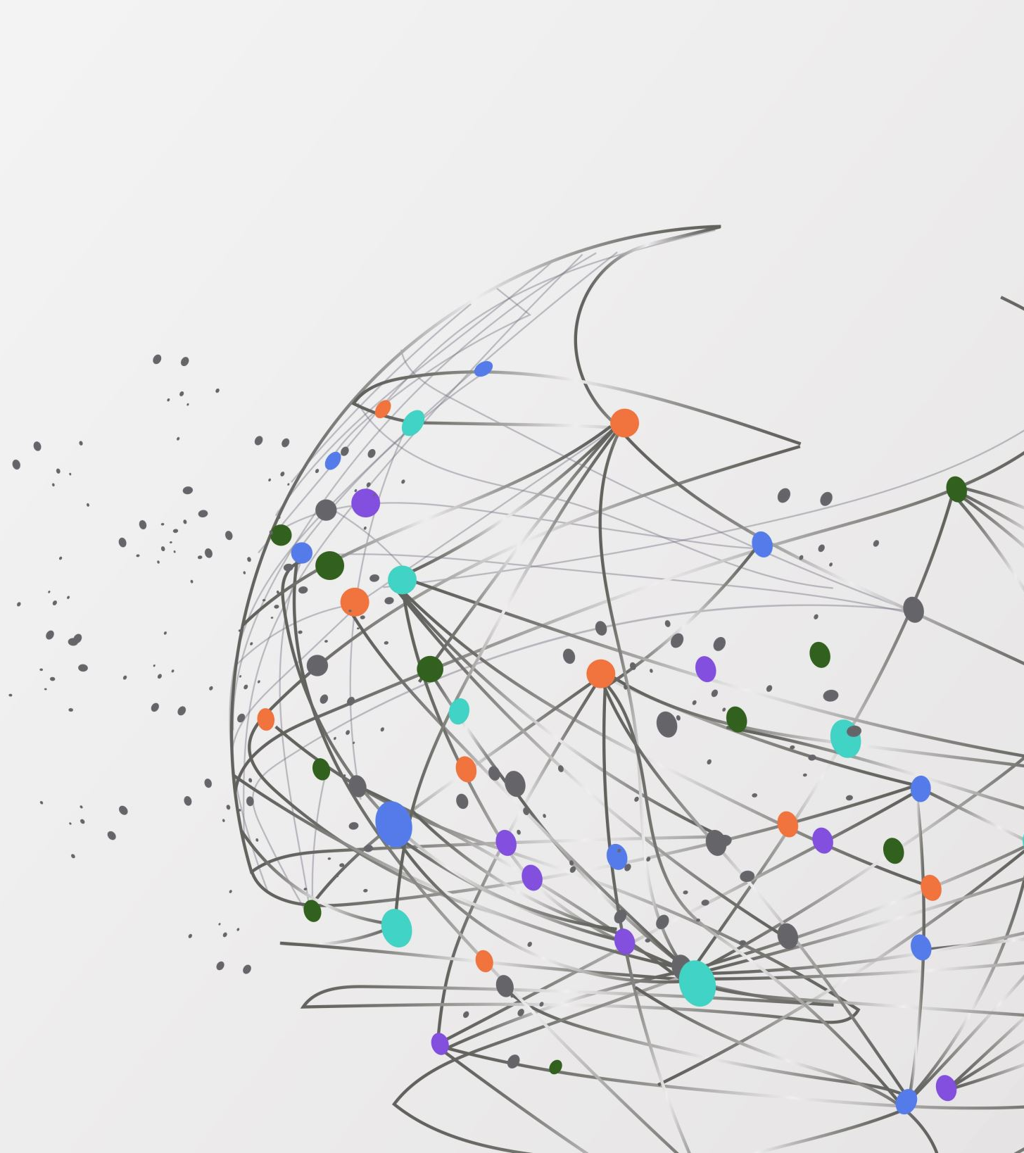
Is Agile The Answer?
Notes:
Agile is a good process, but it tends to be something that either works, or doesn’t work. Not all organizations can support Agile development, but if you can support this style with resources, is it the best approach to development?

Slide 41

Benefits of Agile
Can be rolled back when needed
Adapts well to a market prone to dynamic change
You don’t need to know what the end-state looks like

Slide 42

Disadvantages to Agile
Requires constant communication
Daily standups
Can be chaotic for inexperienced leadership

Slide 43
Alternatives to Agile
Waterfall
Rapid Application Development (RAD)
Lean
Extreme Programming (XP)
Feature Driven (FDD)
Notes:
Each of these approaches can be applied to the Software Development Life Cycle. You might decide to use one over another depending on what outcomes you’re looking for.

Slide 44

Waterfall

Slide 45
Advantages Of Waterfall
Easier to manage both the team, and budget
Works well when change is not expected to come to the market
Clear deadlines, requirements and tasks

Slide 46
Disadvantages of Waterfall
Very rigid
Demands that each stage of the SDLC be performed regardless of externalities
Slow to respond to immediate needs

Slide 47

Lean

Slide 48
Advantages Of Lean
Better for adapting to low-budgets
Allows for prioritization of unpredictable needs/rapid market changes
Optimizes tasking to avoid waste of time and resources

Slide 49

Disadvantages of Lean
Very basic approach to SDLC
Stripped-down approach may not allow enough time to focus on quality feature development

Slide 50

Review Day 1

Slide 51

Question or clarifications?

Slide 52

Preview day 2

Slide 53
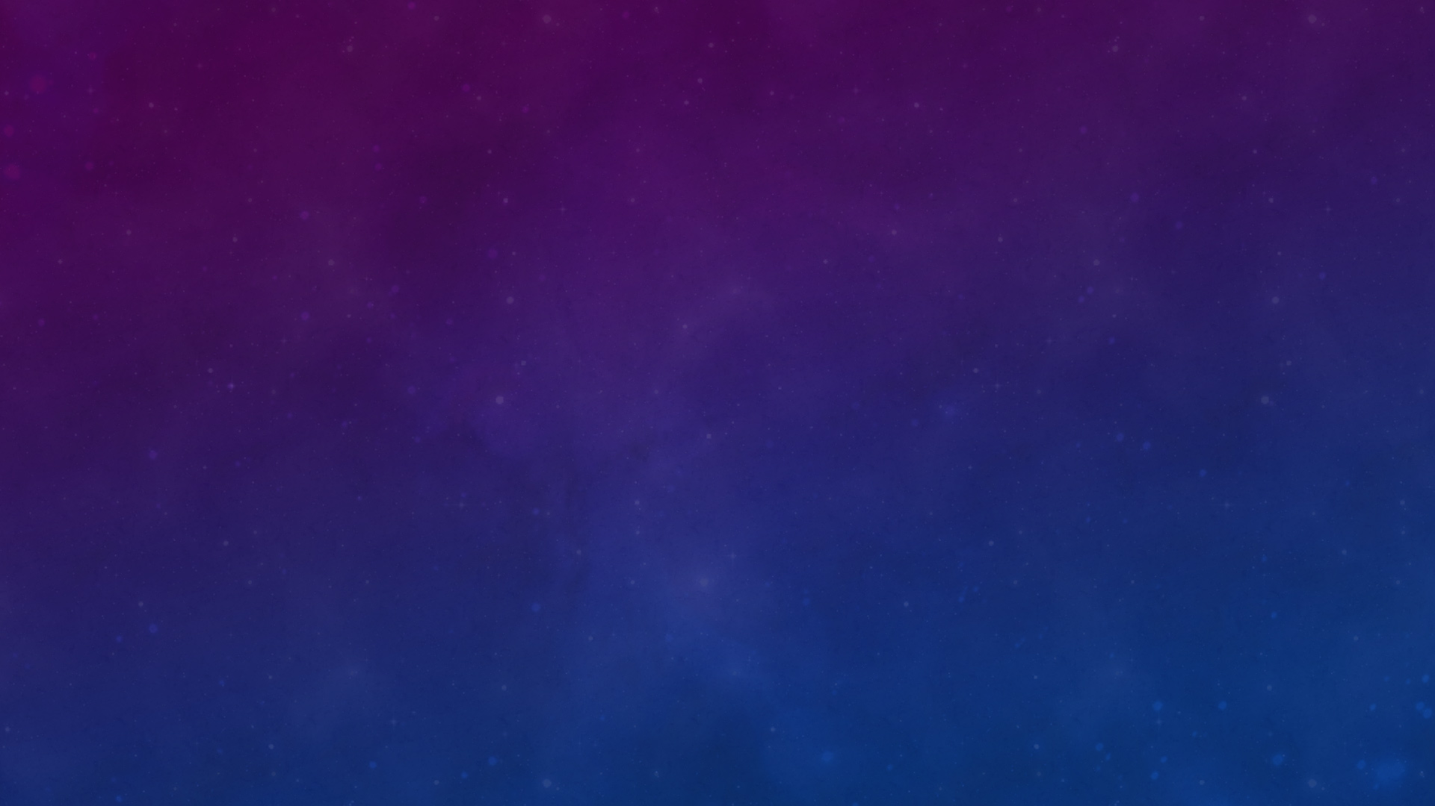
See you next time!

